Slide 1
Principles of International Finance and Open Economy Macroeconomics
Cristina Terra

Slide 2
Chapter 7
Macroeconomic Policies and Exchange Rate in the Short-Run
Cristina Terra

Slide 3
Introduction
In general, prices do not adjust instantly to economic shocks.
  Explanations:
    menu costs;
    contracts that do not allow an immediate price adjustment; or
    asymmetric information problems that can delay the transfer of shocks to prices.
In the short-run, or when relative prices have not had time to adjust to economic shocks, relative prices can differ from their equilibrium value
  => the current account and the aggregate output to also differ from their long-run equilibrium level.

Slide 4
Introduction
In this chapter we will study two sticky price models.
  The Mundell-Fleming model:
    prices are maintained fixed.
    The very short-run: no economic shocks are transferred to prices.
  The Mundell-Fleming-Dornbusch model:
    prices adjust, however slowly, according to the convergence rule for their long-run value.
    It allows the analysis of the real impacts of a monetary shock in the transition period after an economic shock.

Slide 5
Plan
Rigid Prices: The MundellFleming Model
Sticky Prices: The Mundell-Fleming-Dornbusch Model
Monetary Models with Price Rigidity: Their Uses and Limitations

Slide 6
Plan
Rigid Prices: The MundellFleming Model
  Money, Assets, and Goods Markets
  Graphic Representation and Equilibrium
  Monetary and Fiscal Policies Under Fixed and Floating Exchange Rate Regimes
Sticky Prices: The Mundell-Fleming-Dornbusch Model
Monetary Models with Price Rigidity: Their Uses and Limitations

Slide 7
Rigid Prices:
The Mundell-Fleming Model
Developed at the beginning of the 1960s by Robert Mundell and Marcus Fleming, this model is also known as the IS-LM-BP model
  It adds the external sector, represented by the balance of payments (BP), to the equilibrium equation in the goods and money markets – the IS and LM functions, respectively, in Keynesian models.
As prices are taken as being totally rigid, all changes in the nominal exchange rate are translated into RER variations.
The RER variations, in turn, impact the aggregate output of the economy.
Focus: the impact of monetary and fiscal policies under different exchange rate regimes.

Slide 8
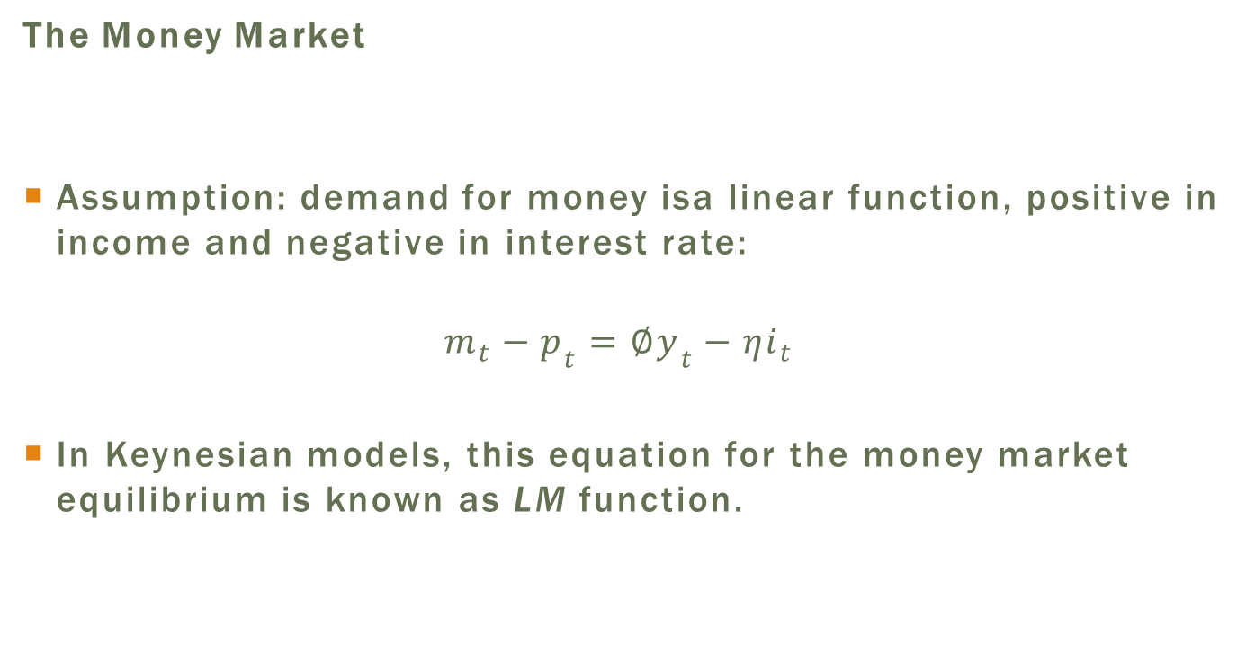
The Money Market
The Money Market
Assumption: demand for money isa linear function, positive in income and negative in interest rate:
$$m_{t}−p_{t}=∅y_{t}−ηi_{t}$$
In Keynesian models, this equation for the money market equilibrium is known as LM function.

Slide 9
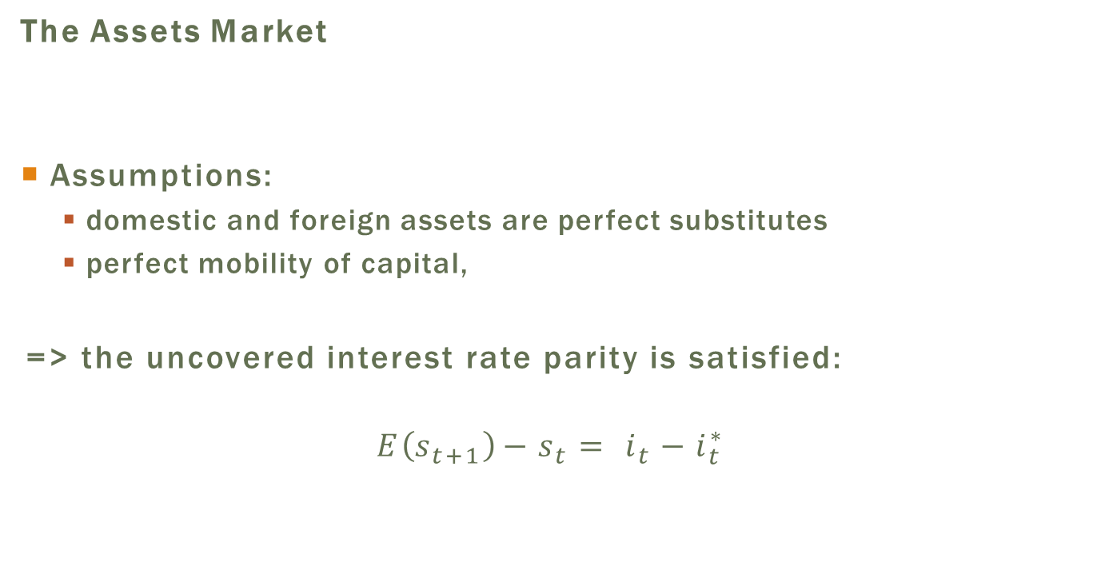
The Assets Markets
The Assets Market
Assumptions:
  domestic and foreign assets are perfect substitutes
  perfect mobility of capital,
=> the uncovered interest rate parity is satisfied:
$$E\left(s_{t+1}\right)−s_{t}= i_{t}−i_{t}^{∗}$$

Slide 10
The Goods Market
The Goods Market
The novelty appears in the goods market.
  In all models seen until now, the economy is always at full employment.
The Mundell-Fleming model assumes that there is slack capacity in the economy
  The level of production is restricted by the aggregate demand.
  This is the main characteristic of the Keynesian models.

Slide 11
The Goods Market
Price rigidity causes variations in the nominal exchange rate to also affect the real exchange rate, which is associated to the trade balance.
Consumption and investment decisions in the economy, in turn, are affected by the interest rate.
Therefore, the combination of the exchange rate and interest rate levels determines aggregate demand, to which production responds to balance the goods market.

Slide 12
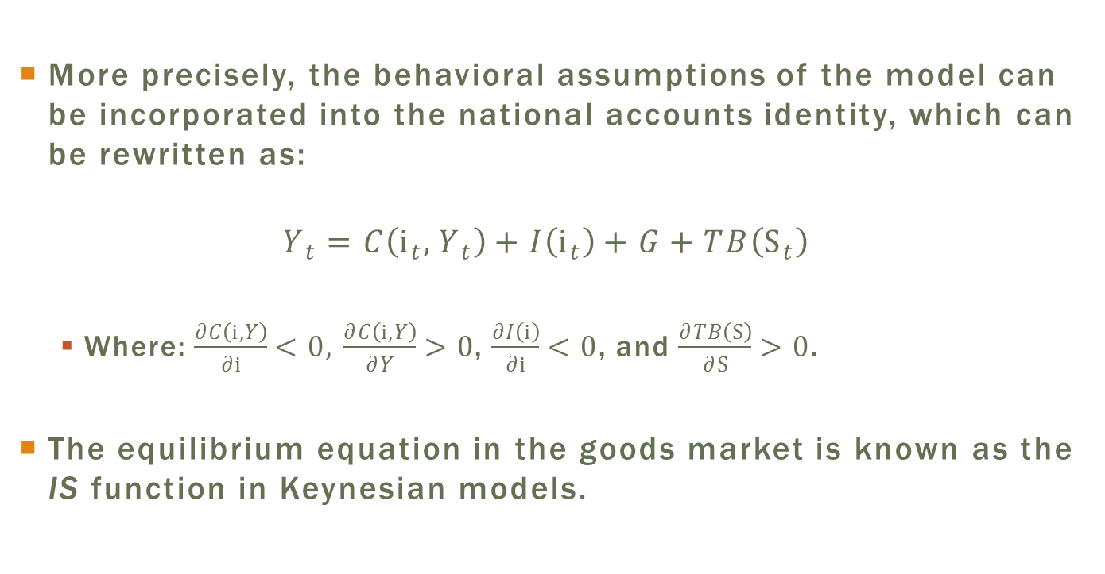
The Goods Market
More precisely, the behavioral assumptions of the model can be incorporated into the national accounts identity, which can be rewritten as:
$$Y_{t}=C\left(i_{t},Y_{t}\right)+I\left(i_{t}\right)+G+TB\left(S_{t}\right)$$
  Where: $\frac{∂C\left(i,Y\right)}{∂i}<0,$ $\frac{∂C\left(i,Y\right)}{∂Y}>0$, $\frac{∂I\left(i\right)}{∂i}<0$, and $\frac{∂TB\left(S\right)}{∂S}>0$.
The equilibrium equation in the goods market is known as the IS function in Keynesian models.

Slide 13
The Goods Market: Consumption
The hypotheses contained in the previous equation can be justified based on the intertemporal models described in Chapters 4 and 5.
Consumption
  Assumption: aggregate consumption is a negative function of interest rates.
  Intertemporal model: higher interest rate makes current consumption relatively more expensive
  => smaller present consumption in relation to future consumption (substitution effect)

Slide 14
The Goods Market: Consumption
Consumption
  Assumption: aggregate consumption is a positive function of income
  Intertemporal model: a temporary increase in income raises aggregate savings in the economy, given that individuals save a part of their extra income to consume more, not only in the present, but also in the future.
  => the increase in consumption is smaller than the increase in income, which is precisely the assumption in the Mundell-Fleming model

Slide 15
The Goods Market: Investment
Investment
  Assumption: investment is a negative function of interest rate.
  Intertemporal model: the optimum investment choice is that which renders the marginal productivity of capital equal to the interest rate.
  Given that the marginal productivity of capital is a decreasing function of capital, a higher interest rate is associated with a lower stock of capital and, consequently, a lower level of investment.

Slide 16
The Goods Market: Trade Balance
Trade balance
  Assumption: trade balance is a positive function of the real exchange rate.
  With fixed price, nominal exchange rate changes automatically translates into changes of the RER.
  Intertemporal model with nontradable goods: a more depreciated real exchange rate is associated with a larger trade balance.
  Intuition: a depreciated exchange rate makes the nontradable good relatively cheaper, stimulating larger production of tradables and consumption of nontradables => higher exports and lower imports.

Slide 17
RER and Trade Balance:
A Dose of Reality
The exchange rate depreciation renders tradable goods relatively more expensive => higher production and lower consumption of tradables => greater surplus to export in the tradable goods sector.
There is, however, a negative effect of exchange rate depreciation on the trade balance, by means of import prices.
This channel was not captured by previous analysis due to the assumption of only one tradable good that can be imported and exported at the international price.
What happens when these hypotheses are relaxed?

Slide 18
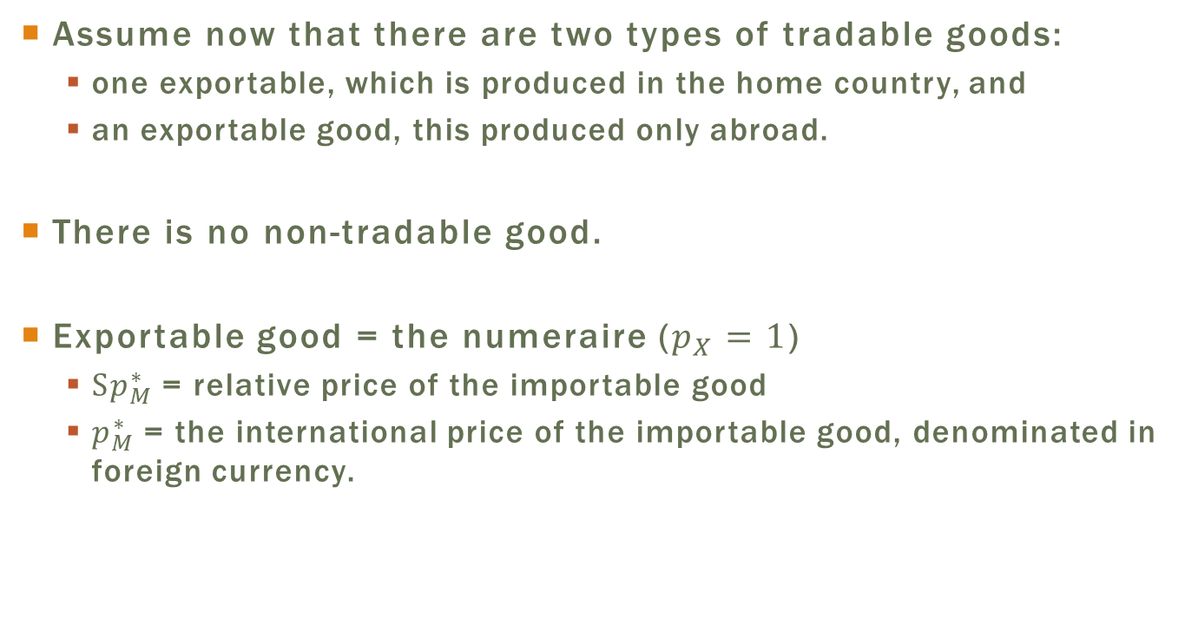
RER and Trade Balance:
A Dose of Reality
Assume now that there are two types of tradable goods:
  one exportable, which is produced in the home country, and
  an exportable good, this produced only abroad.
There is no non-tradable good.
Exportable good = the numeraire ($p_{X}=1$)
  $Sp_{M}^{∗}$ = relative price of the importable good
  $p_{M}^{∗}$ = the international price of the importable good, denominated in foreign currency.

Slide 19
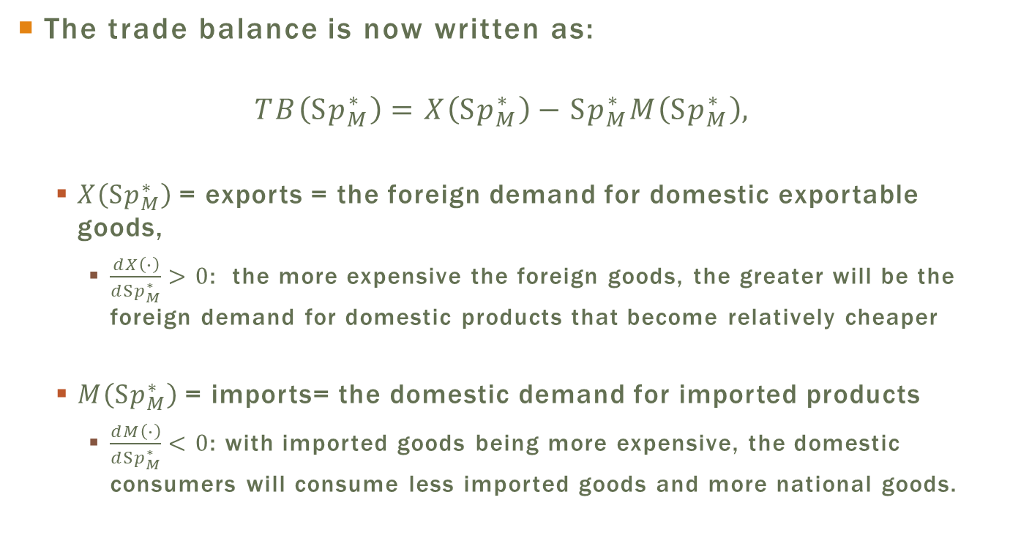
RER and Trade Balance:
A Dose of Reality
The trade balance is now written as:
$$TB\left(Sp_{M}^{∗}\right)=X\left(Sp_{M}^{∗}\right)−Sp_{M}^{∗}M\left(Sp_{M}^{∗}\right),$$
  $X\left(Sp_{M}^{∗}\right)$ = exports = the foreign demand for domestic exportable goods,
    $\frac{dX\left(∙\right)}{dSp_{M}^{∗}}>0$: the more expensive the foreign goods, the greater will be the foreign demand for domestic products that become relatively cheaper
  $M\left(Sp_{M}^{∗}\right)$ = imports= the domestic demand for imported products
    $\frac{dM\left(∙\right)}{dSp_{M}^{∗}}<0$: with imported goods being more expensive, the domestic consumers will consume less imported goods and more national goods.

Slide 20
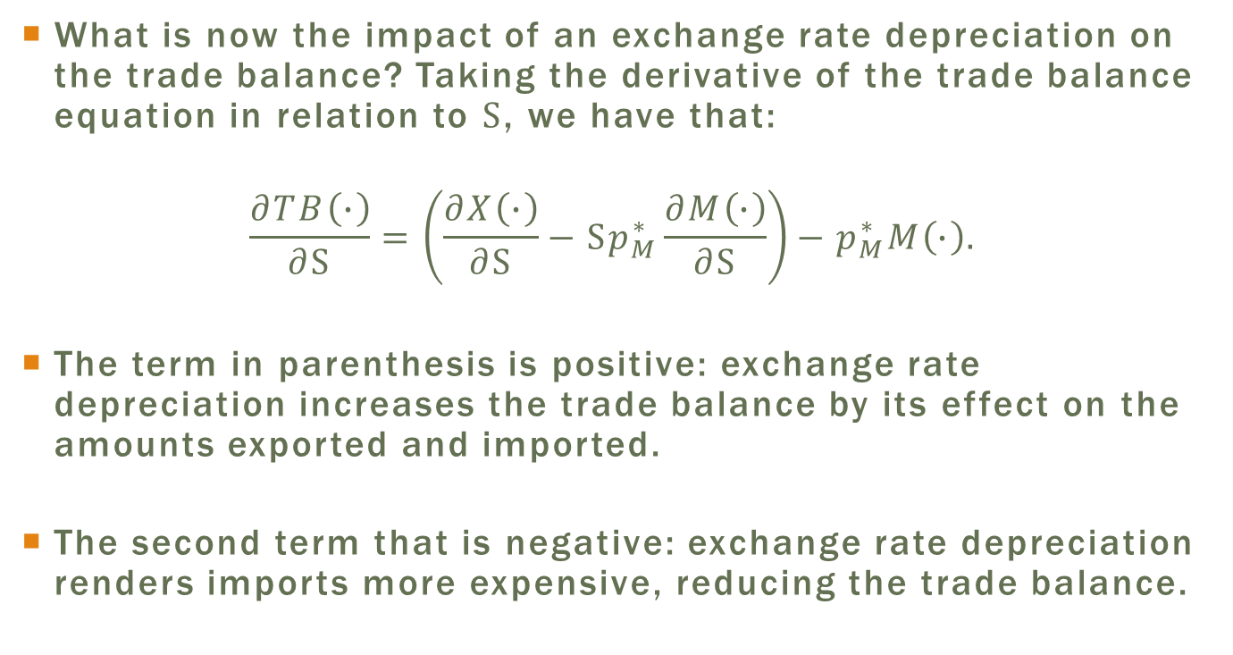
RER and Trade Balance:
A Dose of Reality
What is now the impact of an exchange rate depreciation on the trade balance? Taking the derivative of the trade balance equation in relation to $S$, we have that:
$$\frac{∂TB\left(∙\right)}{∂S}=\left(\frac{∂X\left(∙\right)}{∂S}−Sp_{M}^{∗}\frac{∂M\left(∙\right)}{∂S}\right)−p_{M}^{∗}M\left(∙\right).$$
The term in parenthesis is positive: exchange rate depreciation increases the trade balance by its effect on the amounts exported and imported.
The second term that is negative: exchange rate depreciation renders imports more expensive, reducing the trade balance.

Slide 21
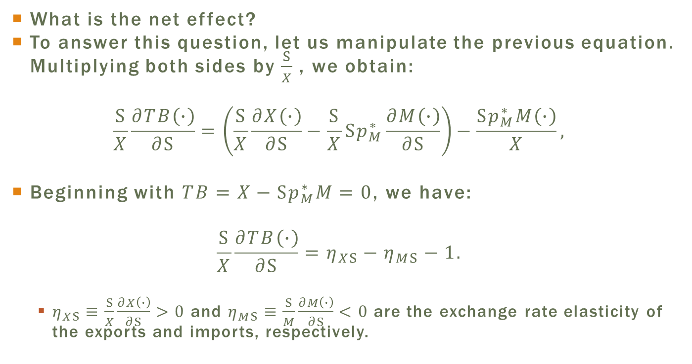
The Marshall-Lerner Condition
What is the net effect?
To answer this question, let us manipulate the previous equation. Multiplying both sides by $\frac{S}{X}$ , we obtain:
$$\frac{S}{X}\frac{∂TB\left(∙\right)}{∂S}=\left(\frac{S}{X}\frac{∂X\left(∙\right)}{∂S}−\frac{S}{X}Sp_{M}^{∗}\frac{∂M\left(∙\right)}{∂S}\right)−\frac{Sp_{M}^{∗}M\left(∙\right)}{X},$$
Beginning with $TB=X−Sp_{M}^{∗}M=0$, we have:
$$\frac{S}{X}\frac{∂TB\left(∙\right)}{∂S}=η_{XS}−η_{MS}−1.$$
  $η_{XS}≡\frac{S}{X}\frac{∂X\left(∙\right)}{∂S}>0$ and $η_{MS}≡\frac{S}{M}\frac{∂M\left(∙\right)}{∂S}<0$ are the exchange rate elasticity of the exports and imports, respectively.

Slide 22
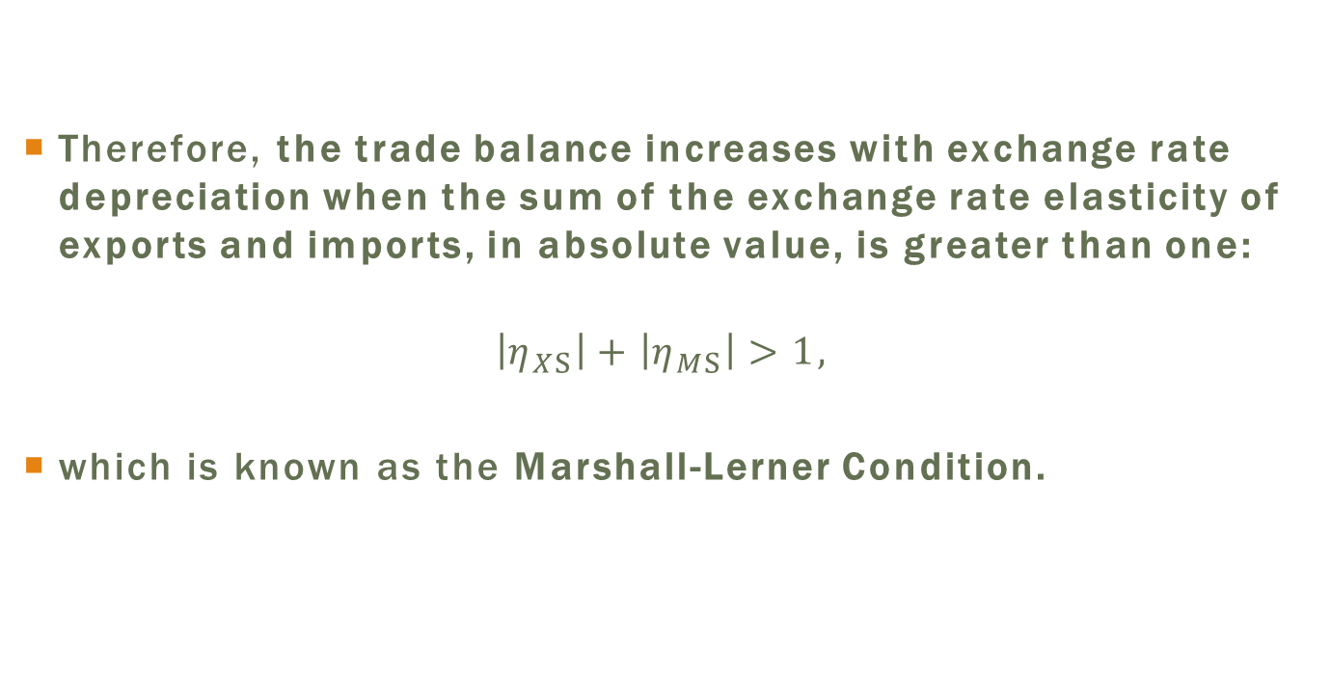
The Marshall-Lerner Condition
Therefore, the trade balance increases with exchange rate depreciation when the sum of the exchange rate elasticity of exports and imports, in absolute value, is greater than one:
$$\left|η_{XS}\right|+\left|η_{MS}\right|>1,$$
which is known as the Marshall-Lerner Condition.

Slide 23
J-Curve
Even if the Marshall-Lerner condition is satisfied, the impact of exchange rate depreciation on the amounts exported and imported is generally not immediate.
The initial result of exchange rate depreciation is, actually, a deterioration of the trade balance due to its direct and immediate effect on the price of imports.
The positive effect appears later, after the export and import decisions respond to the incentive given by the depreciated exchange rate. The trade adjustment forms, therefore, a curve in the form of a J.

Slide 24
Graphic Representation and Equilibrium
The economy is in equilibrium when the money, assets and goods markets are in equilibrium.
  Choice variables for government: money supply and public spending
  Variables endogenously determined in the model: interest rate, output level and exchange rate.
The economy equilibrium is represented in Figure 7.1.
Right quadrant: equilibrium in the goods (IS) and money (LM) markets.

Slide 25
Equilibrium in the mundell Fleming Model

Slide 26
IS curve
Negative slope of IS curve: higher interest rates => lower investment and lower consumption = lower aggregate demand
  Output is constrained by demand, so it also decreases.
  Lower output => supplementary fall in consumption, given that this is also a function of output (multiplier effect).
The position of the curve on the graph depends on the level of government spending and the trade balance.
  The greater the value of these two variables, the more distant from the origin the curve will be.
  Intuition: greater spending or greater net exports = greater aggregate demand => a greater output level, for a given interest rate.

Slide 27
Lm Curve
Positive slope of the LM curve: higher interest rates => higher output to maintain the demand for money constant
The position of the LM curve on the graph depends on the level of real money supply:
  The higher the real supply of money, more to the right the curve will position itself.
  A higher money supply should be accompanied by higher demand, which is attained with a higher income level, for a given interest rate.

Slide 28
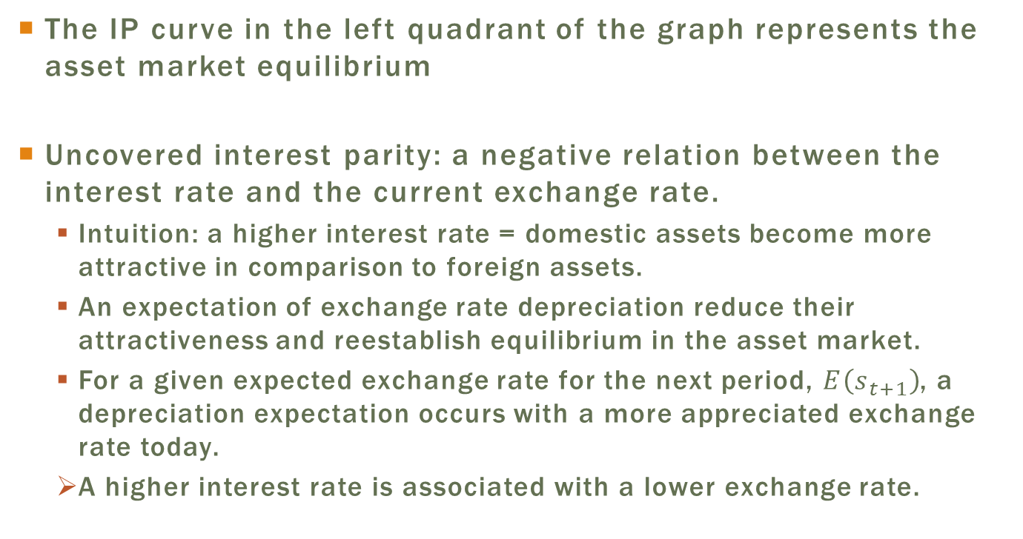
Interest Parity Curve
The IP curve in the left quadrant of the graph represents the asset market equilibrium
Uncovered interest parity: a negative relation between the interest rate and the current exchange rate.
  Intuition: a higher interest rate = domestic assets become more attractive in comparison to foreign assets.
  An expectation of exchange rate depreciation reduce their attractiveness and reestablish equilibrium in the asset market.
  For a given expected exchange rate for the next period, $E\left(s_{t+1}\right)$, a depreciation expectation occurs with a more appreciated exchange rate today.
  A higher interest rate is associated with a lower exchange rate.

Slide 29
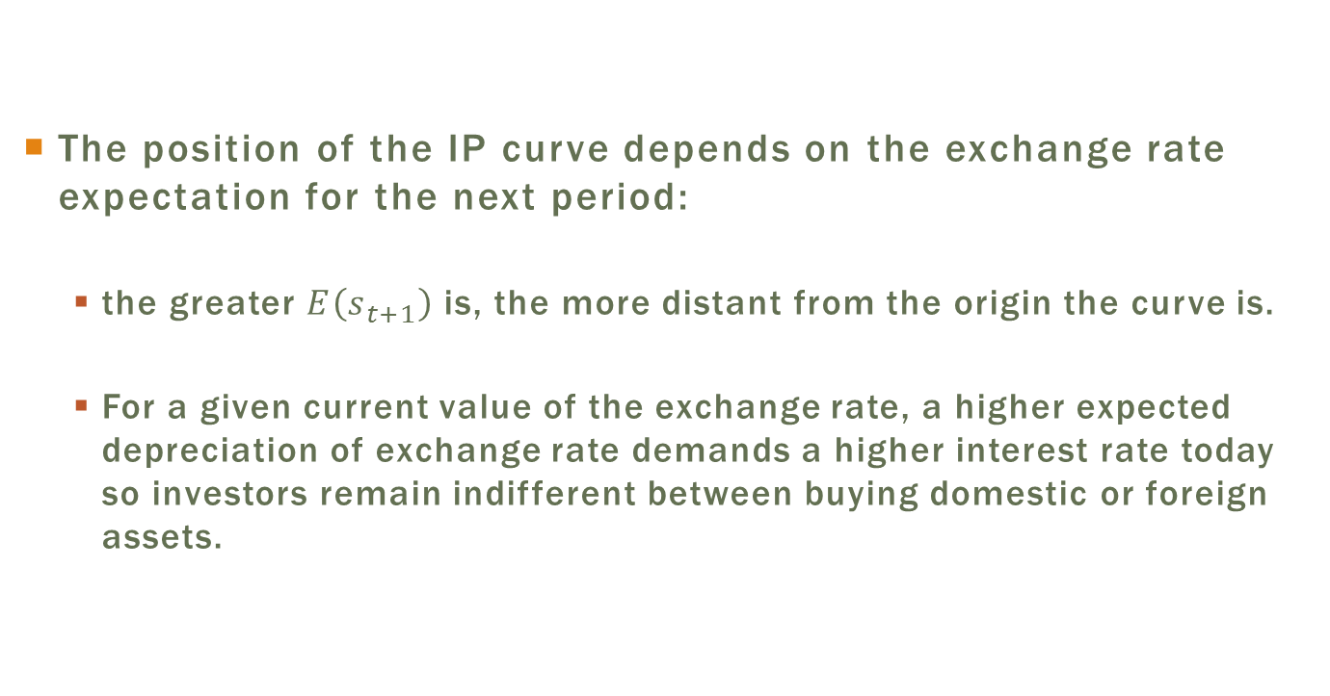
Interest Parity Curve
The position of the IP curve depends on the exchange rate expectation for the next period:
  the greater $E\left(s_{t+1}\right)$ is, the more distant from the origin the curve is.
  For a given current value of the exchange rate, a higher expected depreciation of exchange rate demands a higher interest rate today so investors remain indifferent between buying domestic or foreign assets.

Slide 30
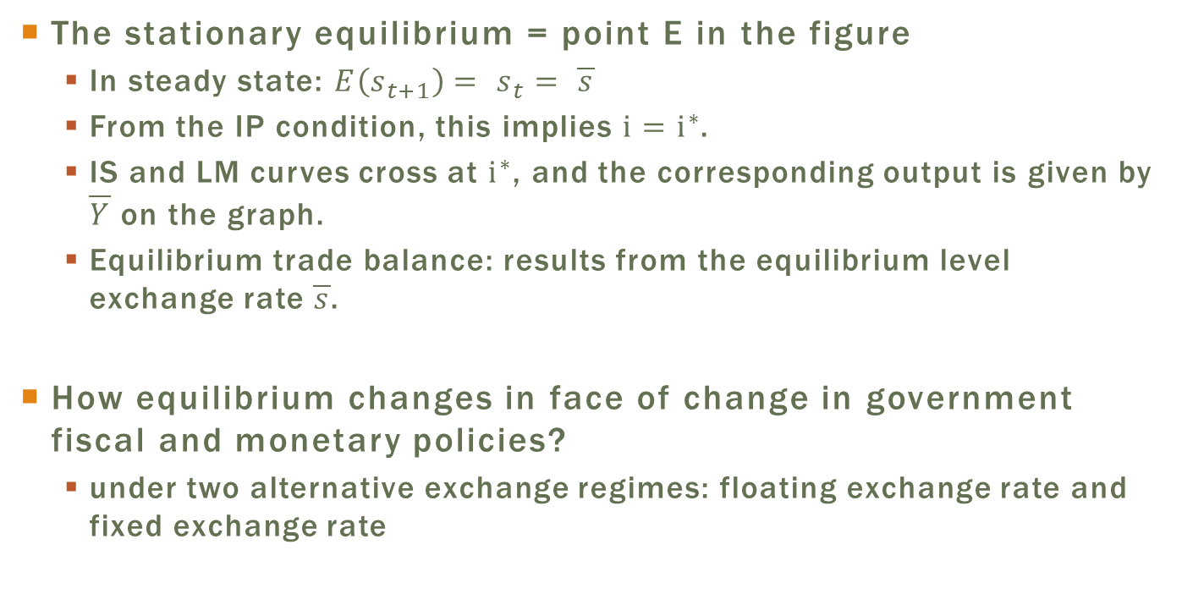
Steady-state equilibrium
The stationary equilibrium = point E in the figure
  In steady state: $E\left(s_{t+1}\right)= s_{t}= \overline{s}$
  From the IP condition, this implies $i=i^{∗}$.
  IS and LM curves cross at $i^{∗}$, and the corresponding output is given by $\overline{Y}$ on the graph.
  Equilibrium trade balance: results from the equilibrium level exchange rate $\overline{s}$.
How equilibrium changes in face of change in government fiscal and monetary policies?
  under two alternative exchange regimes: floating exchange rate and fixed exchange rate

Slide 31
Monetary and Fiscal Policies under Fixed and Floating
Exchange Rate Regimes
Basic difference between the fixed and floating exchange rate regimes: monetary policy.
  Fixed regime: the government commits to intervene in the exchange rate market to set its price.
    Money supply decreases in the face of pressure to depreciate, and
    it increases when there is a pressure for exchange rate appreciation.
    =>Monetary policy has become passive in the sense that it is used to maintain the nominal exchange rate at a given level.
  Floating regime: no commitment to defend an exchange rate parity
    the government can buy and sell its bonds on the open market in order to adjust the money supply in a completely exogenous way.

Slide 32
Monetary and Fiscal Policies under Fixed and Floating
Exchange Rate Regimes
We will now see how a small, open economy with free capital mobility reacts to changes in monetary and fiscal policies under fixed and floating exchange rate regimes.
Warning: The Mundell-Fleming model does not allow the analysis of the transition between different short-run equilibria.
  I propose an intuition for the economic mechanisms that lead the economy to a new equilibrium after a change in economic policy, even though the model does not allow an analysis of the dynamics.

Slide 33
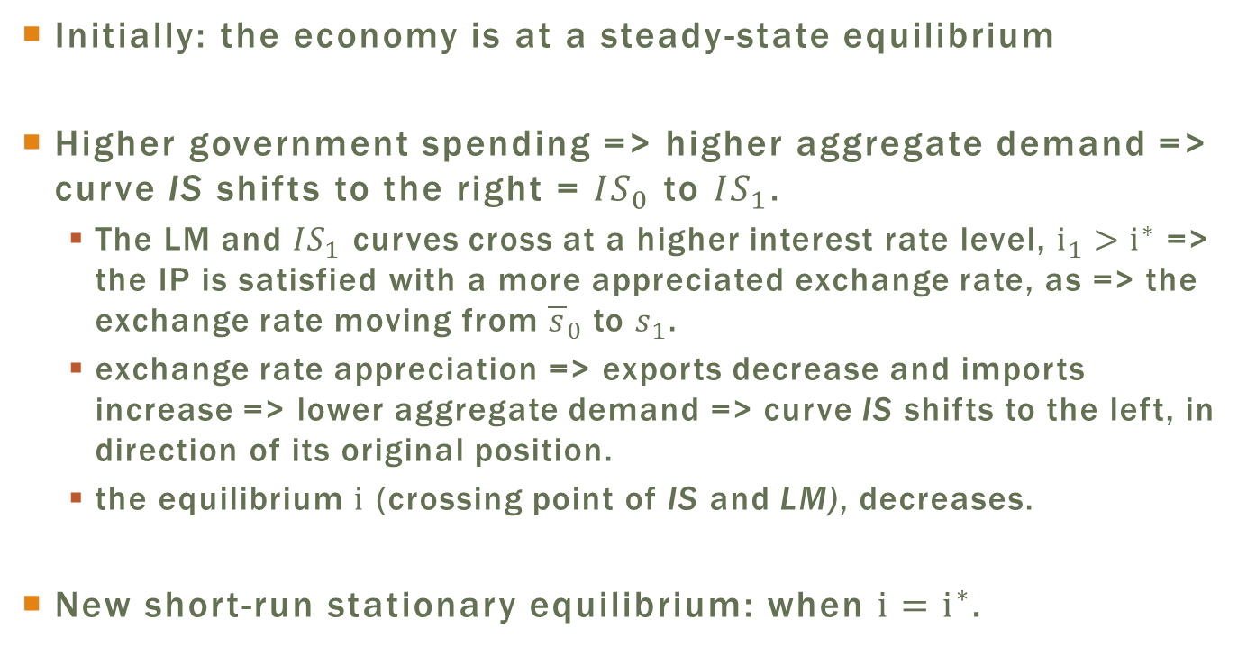
Floating Exchange Rate Regime:
Permanent Fiscal Expansion
Initially: the economy is at a steady-state equilibrium
Higher government spending => higher aggregate demand => curve IS shifts to the right = ${IS}_{0}$ to ${IS}_{1}$.
  The LM and ${IS}_{1}$ curves cross at a higher interest rate level, $i_{1}>i^{∗}$ => the IP is satisfied with a more appreciated exchange rate, as => the exchange rate moving from ${\overline{s}}_{0}$ to $s_{1}$.
  exchange rate appreciation => exports decrease and imports increase => lower aggregate demand => curve IS shifts to the left, in direction of its original position.
  the equilibrium $i$ (crossing point of IS and LM), decreases.
New short-run stationary equilibrium: when $i=i^{∗}$.

Slide 34
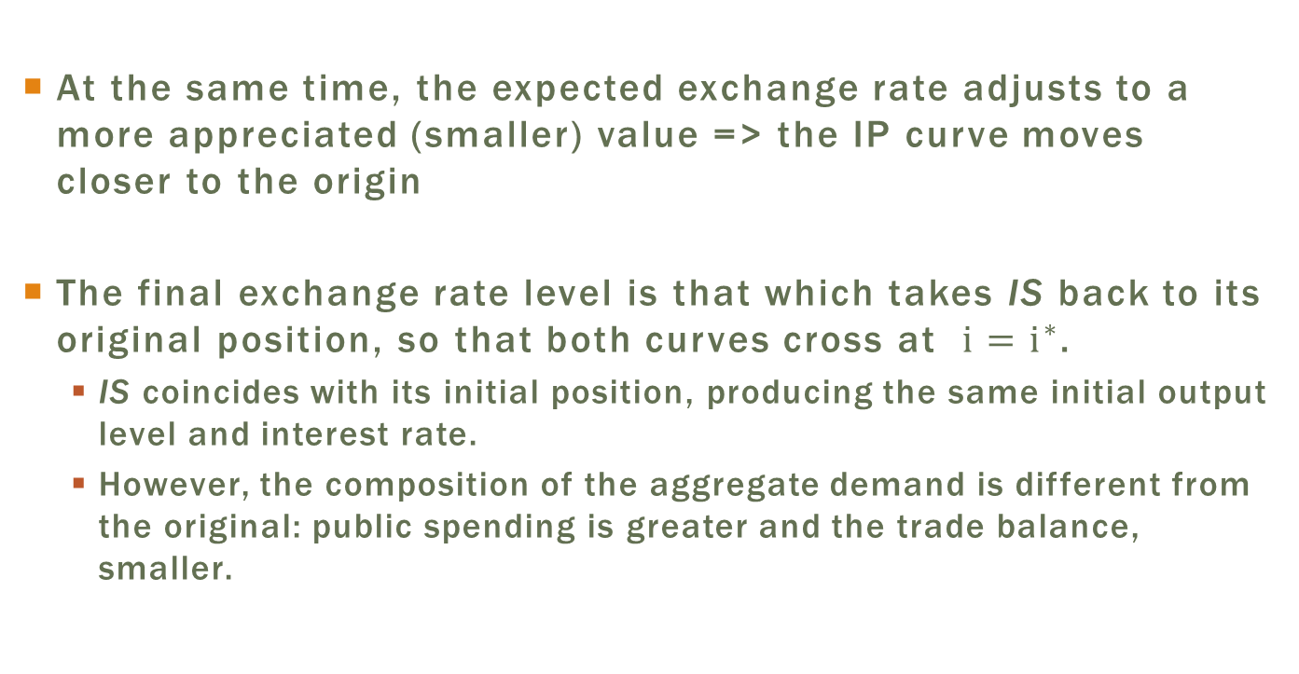
Floating Exchange Rate Regime:
Permanent Fiscal Expansion
At the same time, the expected exchange rate adjusts to a more appreciated (smaller) value => the IP curve moves closer to the origin
The final exchange rate level is that which takes IS back to its original position, so that both curves cross at $i=i^{∗}$.
  IS coincides with its initial position, producing the same initial output level and interest rate.
  However, the composition of the aggregate demand is different from the original: public spending is greater and the trade balance, smaller.

Slide 35
Floating Exchange Rate Regime:
Permanent Fiscal Expansion
In sum, in a floating exchange rate regime, an increase in public spending is counterbalanced by a reduction in net exports to the same extent, so that the output level remains unaltered.
A reduction in public spending: an inverse effect
  exchange rate depreciation => greater trade balance, which would compensate the initial reduction in expenditures => output unaltered.

Slide 36
Permanent Fiscal Expansion under a Floating Exchange Rate Regime

Slide 37
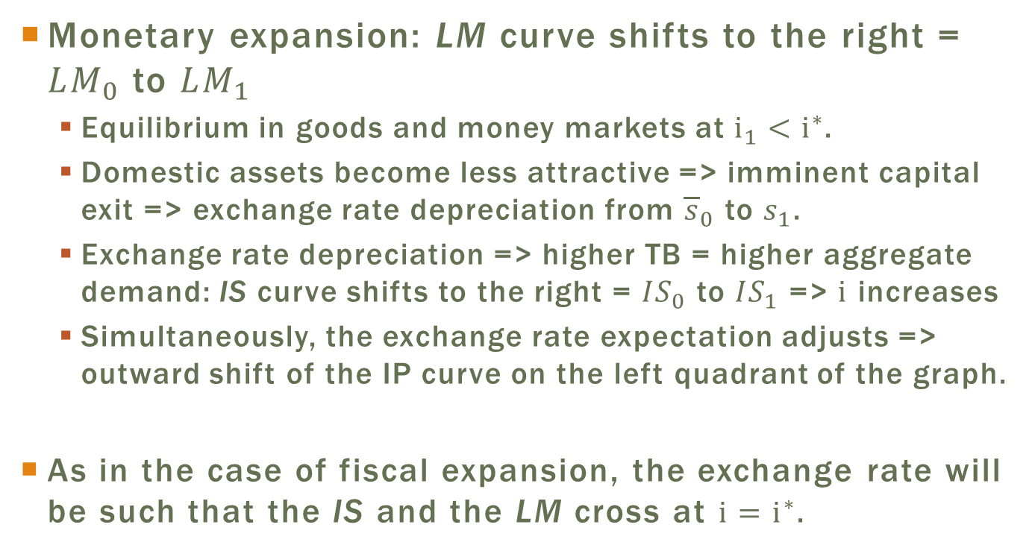
Floating Exchange Rate Regime:
Permanent Monetary Expansion
Monetary expansion: LM curve shifts to the right = ${LM}_{0}$ to ${LM}_{1}$
  Equilibrium in goods and money markets at $i_{1}<i^{∗}$.
  Domestic assets become less attractive => imminent capital exit => exchange rate depreciation from ${\overline{s}}_{0}$ to $s_{1}$.
  Exchange rate depreciation => higher TB = higher aggregate demand: IS curve shifts to the right = ${IS}_{0}$ to ${IS}_{1}$ => $i$ increases
  Simultaneously, the exchange rate expectation adjusts => outward shift of the IP curve on the left quadrant of the graph.
As in the case of fiscal expansion, the exchange rate will be such that the IS and the LM cross at $i=i^{∗}$.

Slide 38
Floating Exchange Rate Regime:
Permanent Monetary Expansion
In sum, monetary expansion in a floating exchange rate regime causes an increase in output level due to the increase of aggregate demand induced by the rise in net exports.
The interest rate, as always is the case in equilibrium, is equal to the international rate, while the exchange rate is more depreciated in relation to its initial level.

Slide 39
Permanent Monetary Expansion under a Floating Exchange Rate Regime

Slide 40
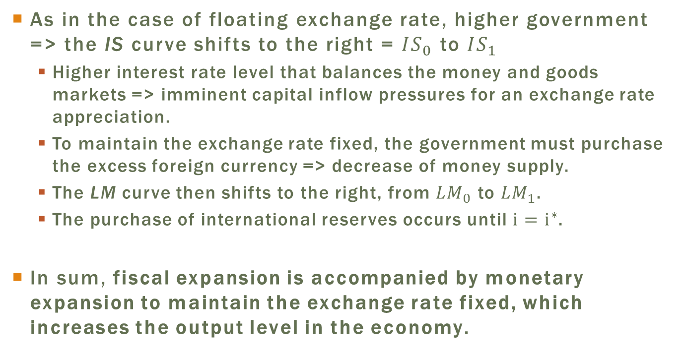
Fixed Exchange Rate Regime:
Permanent Fiscal Expansion
As in the case of floating exchange rate, higher government => the IS curve shifts to the right = ${IS}_{0}$ to ${IS}_{1}$
  Higher interest rate level that balances the money and goods markets => imminent capital inflow pressures for an exchange rate appreciation.
  To maintain the exchange rate fixed, the government must purchase the excess foreign currency => decrease of money supply.
  The LM curve then shifts to the right, from ${LM}_{0}$ to ${LM}_{1}$.
  The purchase of international reserves occurs until $i=i^{∗}$.
In sum, fiscal expansion is accompanied by monetary expansion to maintain the exchange rate fixed, which increases the output level in the economy.

Slide 41
Permanent Fiscal Expansion under a Fixed Exchange Rate Regime

Slide 42
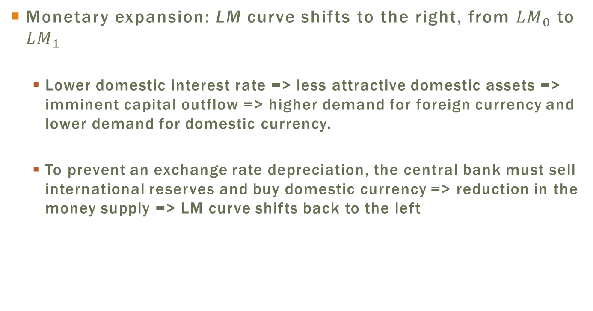
Fixed Exchange Rate Regime: Permanent Monetary Expansion
Monetary expansion: LM curve shifts to the right, from ${LM}_{0}$ to ${LM}_{1}$
  Lower domestic interest rate => less attractive domestic assets => imminent capital outflow => higher demand for foreign currency and lower demand for domestic currency.
  To prevent an exchange rate depreciation, the central bank must sell international reserves and buy domestic currency => reduction in the money supply => LM curve shifts back to the left

Slide 43
Fixed Exchange Rate Regime: Permanent Monetary Expansion
The initial monetary expansion is accompanied by a reduction in reserves at the same level, so that the output, interest rate and exchange rate remain unaltered.
Actually, monetary policy becomes endogenous when a fixed exchange rate is adopted.

Slide 44
Permanent Monetary Expansion under a Fixed Exchange Rate Regime

Slide 45
Summary of Results
Table 7.1: Summary of the Mundell-Fleming Model Results
Exchange Rate Regime | Expansionist Monetary Policy | Expansionist Fiscal Policy
Floating Exchange Rate | Output increase | Output level unaltered
 | Exchange rate depreciation | Exchange rate appreciation
 | Trade balance increase | Trade balance reduction
Fixed Exchange Rate | Output unaltered | Increase in output
 | Lower international reserves | Higher international reserves

Slide 46
Plan
Rigid Prices: The MundellFleming Model
Sticky Prices: The Mundell-Fleming-Dornbusch Model
  Money, Assets, and Goods Markets
  Real Exchange Rate Dynamic
  Nominal Exchange Rate Dynamics
  Dynamic Equilibrium
  Impact of an Expansionist Monetary Policy
Monetary Models with Price Rigidity: Their Uses and Limitations

Slide 47
Sticky Prices: The Mundell-Fleming-Dornbusch Model
Mundell-Fleming model: useful for very short-run, when prices have not yet adjusted to shocks or policy changes.
However, as prices are always fixed in that model, it is not possible to analyze the evolution of the economy over time.
Dornbusch (1976) adds the dynamic of prices to the model, making it more realistic.
  It offers a simple structure to analyze the impact of nominal and real shocks on the exchange rate.
  Main prediction: the exchange rate responds excessively to permanent monetary shocks, known as exchange rate overshooting.

Slide 48
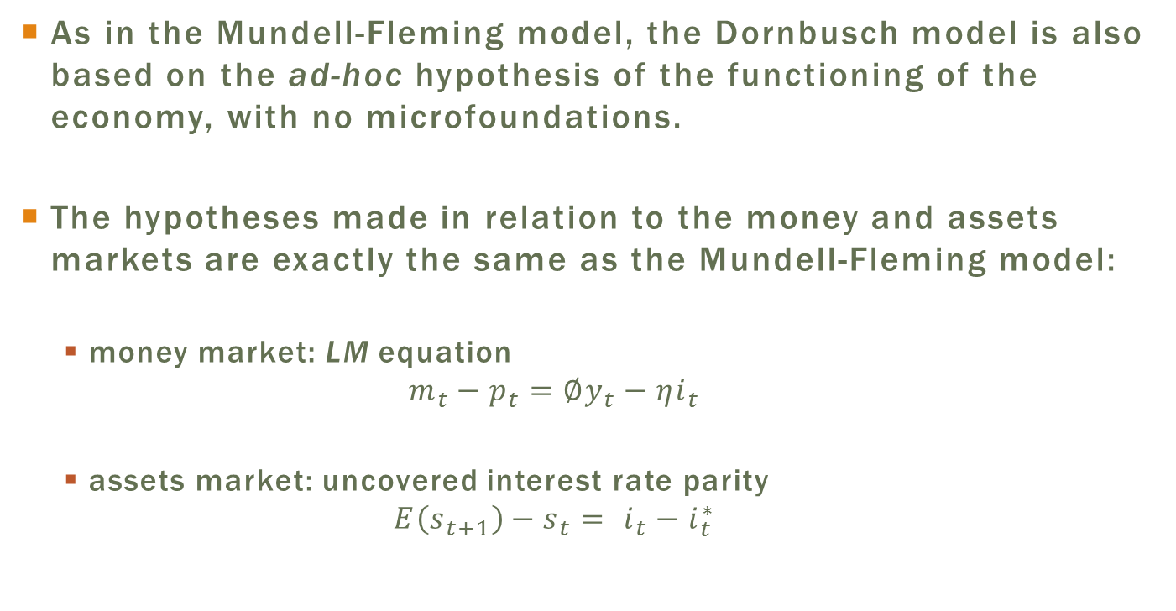
Money and Assets Markets
As in the Mundell-Fleming model, the Dornbusch model is also based on the ad-hoc hypothesis of the functioning of the economy, with no microfoundations.
The hypotheses made in relation to the money and assets markets are exactly the same as the Mundell-Fleming model:
  money market: LM equation
  $$m_{t}−p_{t}=∅y_{t}−ηi_{t}$$
  assets market: uncovered interest rate parity
  $$E\left(s_{t+1}\right)−s_{t}= i_{t}−i_{t}^{∗}$$

Slide 49
The Goods Market
Novelty: the goods market.
In the IS function in the Mundell-Fleming model, the trade balance was merely a function of the nominal exchange rate.
  Prices did not appear in that equation: with fixed prices, as assumed in that model, real exchange rate and nominal exchange rate move together.
In the variation of the model proposed by Dornbusch, prices change over time, so that the real exchange rate comes to figure explicitly in the equation.

Slide 50
The Goods Market
The basic idea is the same: there is slack capability in the economy so that output is determined by aggregate demand.
Two components in the aggregate demand
  A constant one, which corresponds to domestic aggregate demand: C + I + G, and
  a component that changes with the RER: trade balance.

Slide 51
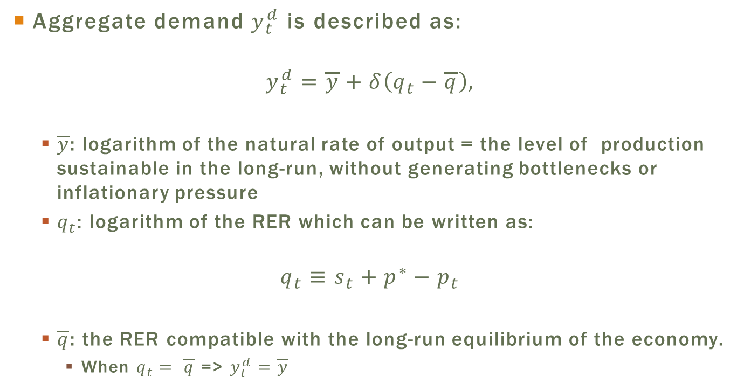
The Goods Market
Aggregate demand $y_{t}^{d}$ is described as:
$$y_{t}^{d}=\overline{y}+δ\left(q_{t}−\overline{q}\right),$$
  $\overline{y}$: logarithm of the natural rate of output = the level of production sustainable in the long-run, without generating bottlenecks or inflationary pressure
  $q_{t}$: logarithm of the RER which can be written as:
$$q_{t}≡s_{t}+p^{∗}−p_{t}$$
  $\overline{q}$: the RER compatible with the long-run equilibrium of the economy.
    When $q_{t}= \overline{q}$ => $y_{t}^{d}=\overline{y}$

Slide 52
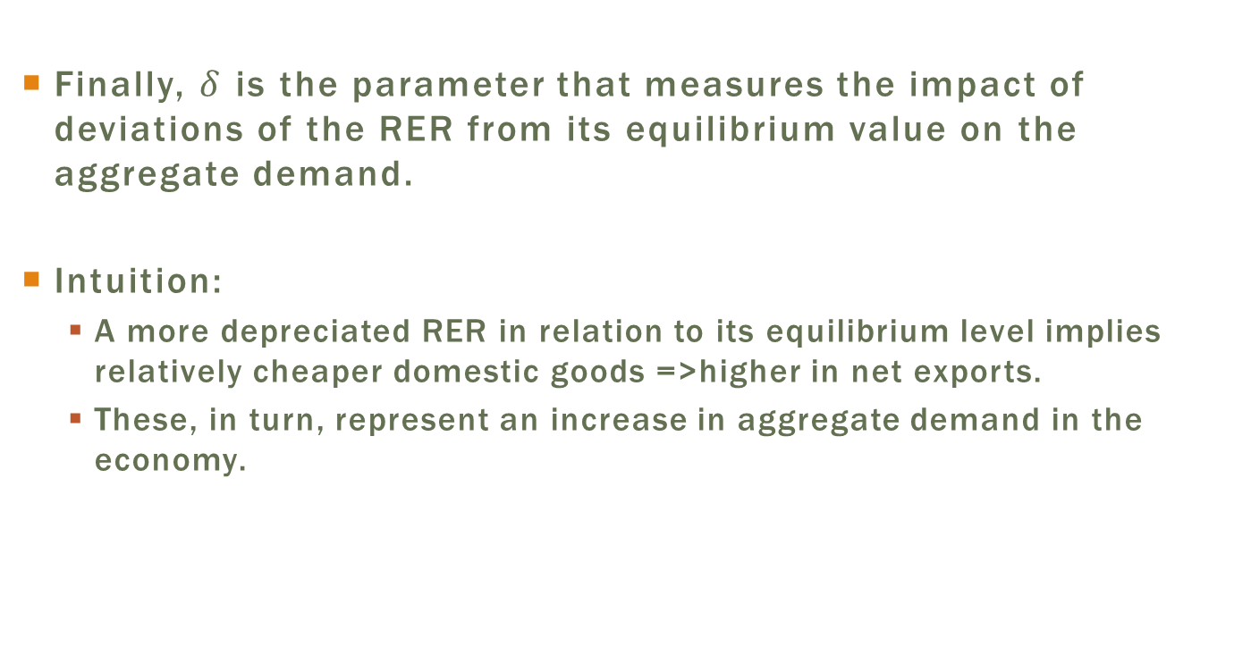
The Goods Market
Finally, $δ$ is the parameter that measures the impact of deviations of the RER from its equilibrium value on the aggregate demand.
Intuition:
  A more depreciated RER in relation to its equilibrium level implies relatively cheaper domestic goods =>higher in net exports.
  These, in turn, represent an increase in aggregate demand in the economy.

Slide 53
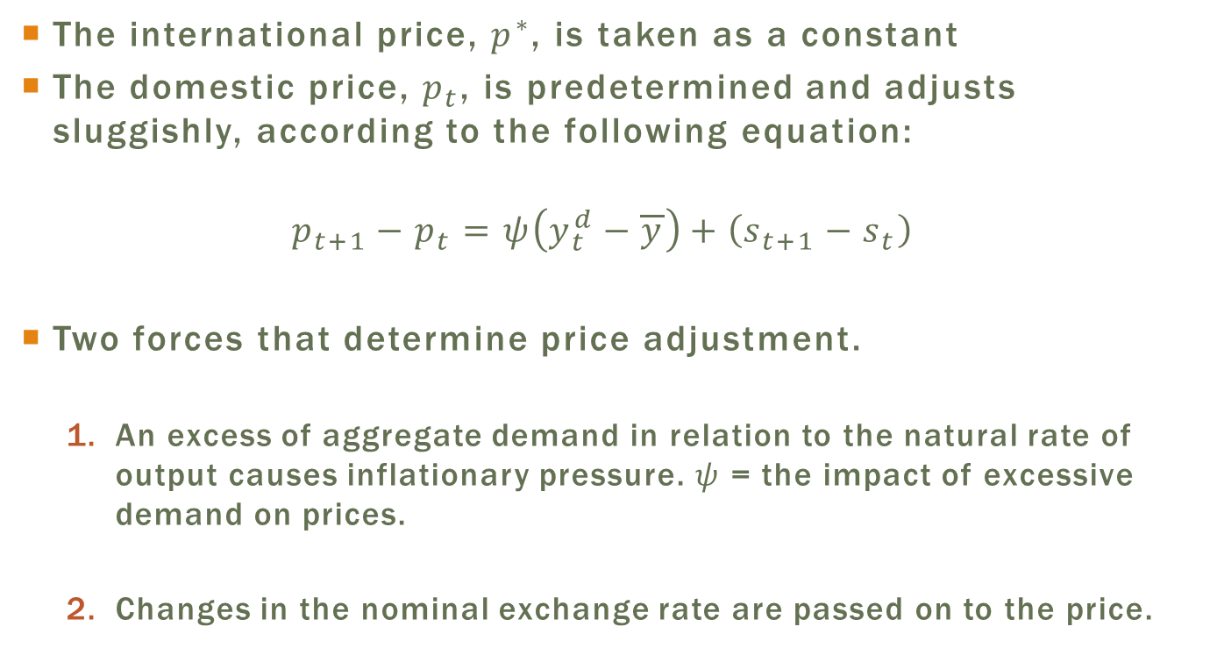
Price Dynamics
The international price, $p^{∗}$, is taken as a constant
The domestic price, $p_{t}$, is predetermined and adjusts sluggishly, according to the following equation:
$$p_{t+1}−p_{t}=ψ\left(y_{t}^{d}−\overline{y}\right)+\left(s_{t+1}−s_{t}\right)$$
Two forces that determine price adjustment.
  An excess of aggregate demand in relation to the natural rate of output causes inflationary pressure. $ψ$ = the impact of excessive demand on prices.
  Changes in the nominal exchange rate are passed on to the price.

Slide 54
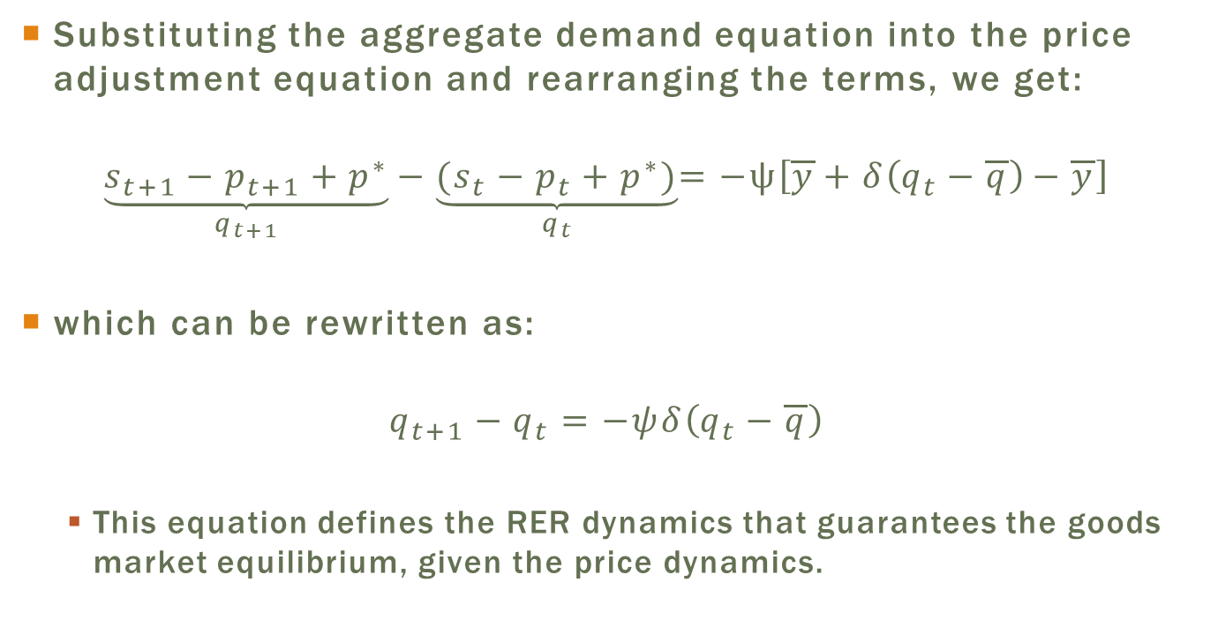
Real Exchange Rate Dynamics
Substituting the aggregate demand equation into the price adjustment equation and rearranging the terms, we get:
$$\underset{q_{t+1}}{\underbrace{s_{t+1}−p_{t+1}+p^{∗}}}−\underset{q_{t}}{\underbrace{(s_{t}−p_{t}+p^{∗})}}=−ψ\left[\overline{y}+δ\left(q_{t}−\overline{q}\right)−\overline{y}\right]$$
which can be rewritten as:
$$q_{t+1}−q_{t}=−ψδ\left(q_{t}−\overline{q}\right)$$
  This equation defines the RER dynamics that guarantees the goods market equilibrium, given the price dynamics.

Slide 55
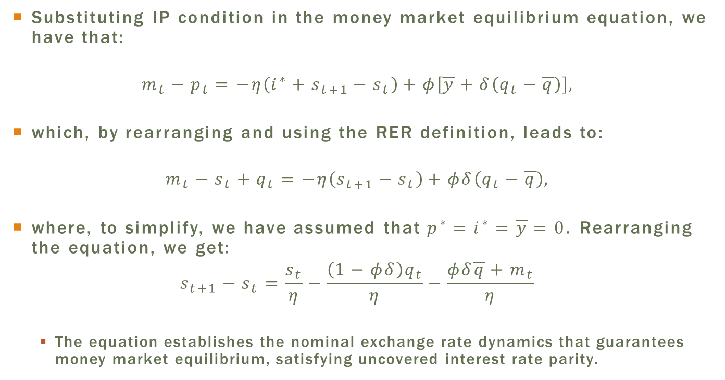
Nominal Exchange Rate Dynamics
Substituting IP condition in the money market equilibrium equation, we have that:
$$m_{t}−p_{t}=−η\left(i^{∗}+s_{t+1}−s_{t}\right)+φ\left[\overline{y}+δ\left(q_{t}−\overline{q}\right)\right],$$
which, by rearranging and using the RER definition, leads to:
$$m_{t}−s_{t}+q_{t}=−η\left(s_{t+1}−s_{t}\right)+φδ\left(q_{t}−\overline{q}\right),$$
where, to simplify, we have assumed that$p^{∗}=i^{∗}=\overline{y}=0$. Rearranging the equation, we get:
$$s_{t+1}−s_{t}=\frac{s_{t}}{η}−\frac{\left(1−φδ\right)q_{t}}{η}−\frac{φδ\overline{q}+m_{t}}{η}$$
  The equation establishes the nominal exchange rate dynamics that guarantees money market equilibrium, satisfying uncovered interest rate parity.

Slide 56
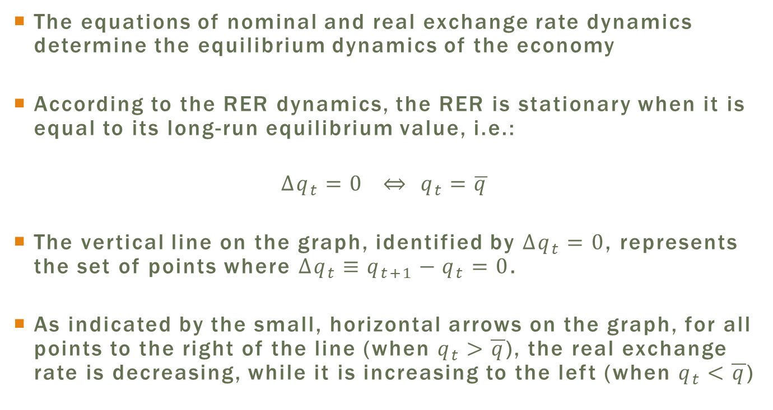
Equilibrium
The equations of nominal and real exchange rate dynamics determine the equilibrium dynamics of the economy
According to the RER dynamics, the RER is stationary when it is equal to its long-run equilibrium value, i.e.:
$$Δq_{t}=0 ⇔ q_{t}=\overline{q}$$
The vertical line on the graph, identified by $Δq_{t}=0$, represents the set of points where $Δq_{t}≡q_{t+1}−q_{t}=0$.
As indicated by the small, horizontal arrows on the graph, for all points to the right of the line (when $q_{t}>\overline{q}$), the real exchange rate is decreasing, while it is increasing to the left (when $q_{t}<\overline{q}$)

Slide 57
Equilibrium in the
Mundell-Fleming-Dornbusch Model

Slide 58
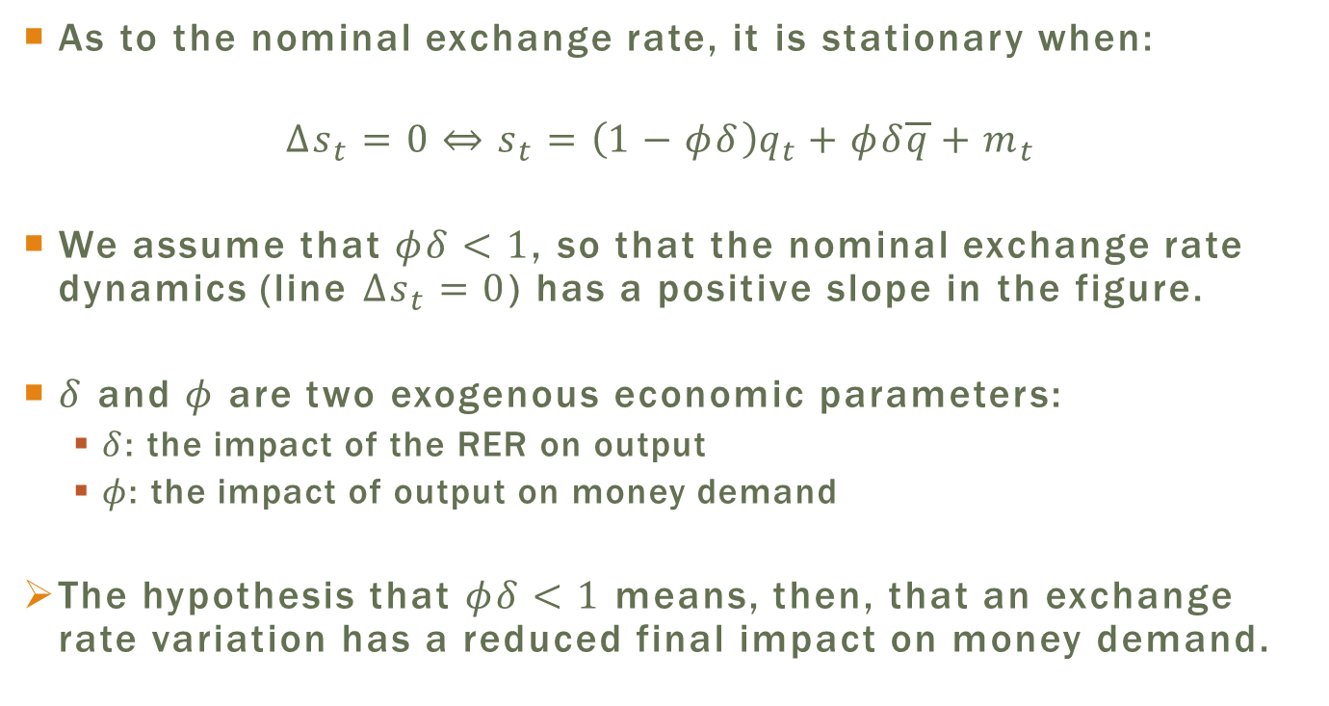
Equilibrium
As to the nominal exchange rate, it is stationary when:
$$Δs_{t}=0⇔s_{t}=\left(1−φδ\right)q_{t}+φδ\overline{q}+m_{t}$$
We assume that $φδ<1$, so that the nominal exchange rate dynamics (line $Δs_{t}=0$) has a positive slope in the figure.
$δ$ and $φ$ are two exogenous economic parameters:
  $δ$: the impact of the RER on output
  $φ$: the impact of output on money demand
The hypothesis that $φδ<1$ means, then, that an exchange rate variation has a reduced final impact on money demand.

Slide 59
Equilibrium
The small vertical arrows indicate the nominal exchange rate dynamics.
  For points above the line, the exchange rate depreciates (i.e. increases) over time. The inverse is true for points below the line.
The economy is in the steady-state when both the nominal exchange rate and the real exchange rate are such that both variable are stationary.
In terms of the figure, this situation corresponds to the crossing point of the two lines, represented by point SS.

Slide 60
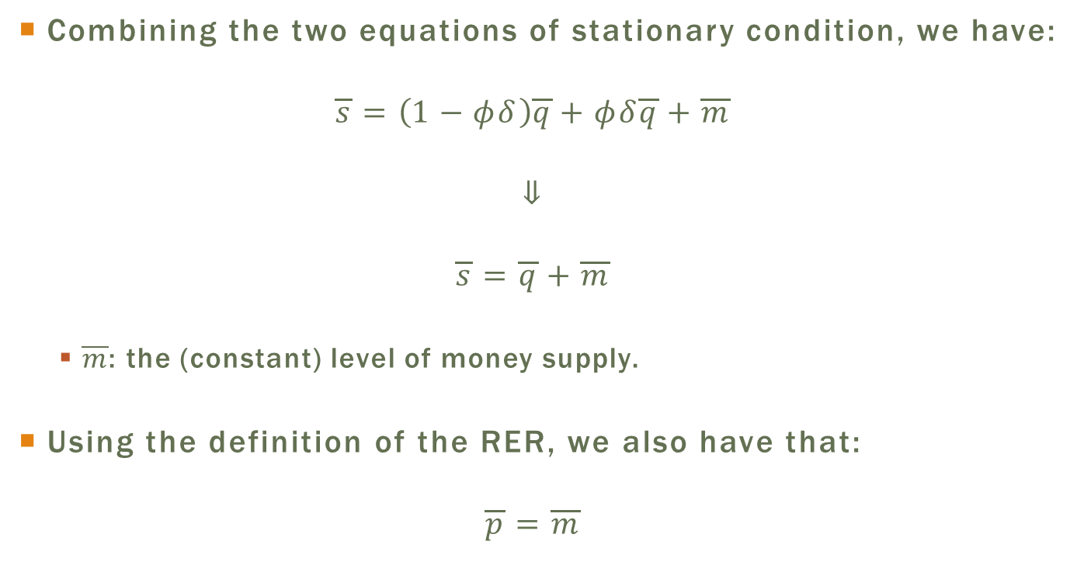
Steady State
Combining the two equations of stationary condition, we have:
$$\overline{s}=\left(1−φδ\right)\overline{q}+φδ\overline{q}+\overline{m}$$
$$⇓$$
$$\overline{s}=\overline{q}+\overline{m}$$
  $\overline{m}$: the (constant) level of money supply.
Using the definition of the RER, we also have that:
$$\overline{p}=\overline{m}$$

Slide 61
Steady State and Equilibrium Paths
If an economy finds itself in the steady-state, it will remain in this state if there are no economic shocks.
What happens when the economy is not in the steady-state?
  The two equations that govern the movement of the two rates and should be satisfied at all times.

Slide 62
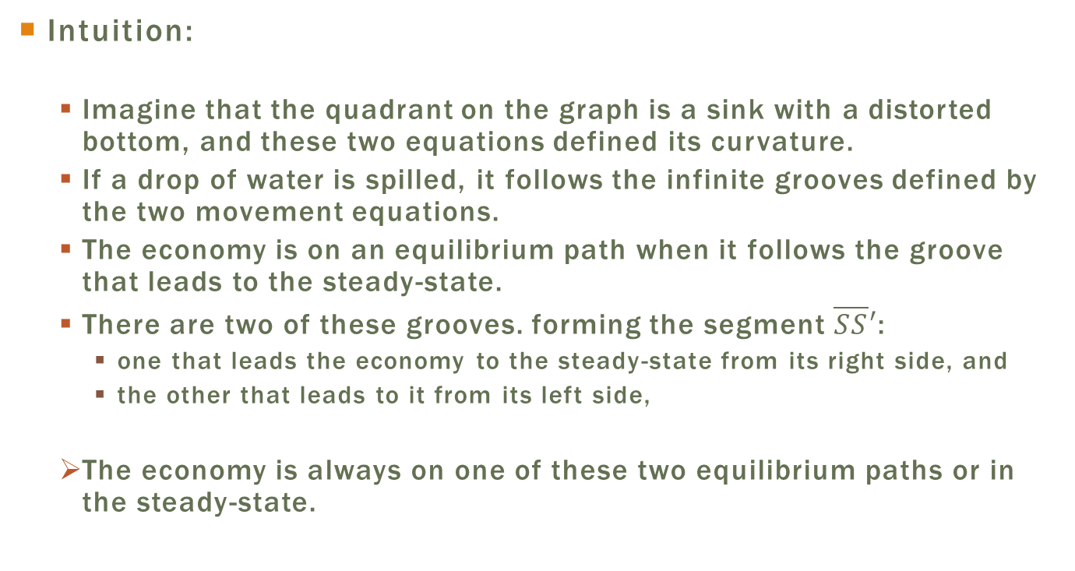
Steady State and Equilibrium Paths
Intuition:
  Imagine that the quadrant on the graph is a sink with a distorted bottom, and these two equations defined its curvature.
  If a drop of water is spilled, it follows the infinite grooves defined by the two movement equations.
  The economy is on an equilibrium path when it follows the groove that leads to the steady-state.
  There are two of these grooves. forming the segment $\overline{SS}′$:
    one that leads the economy to the steady-state from its right side, and
    the other that leads to it from its left side,
  The economy is always on one of these two equilibrium paths or in the steady-state.

Slide 63
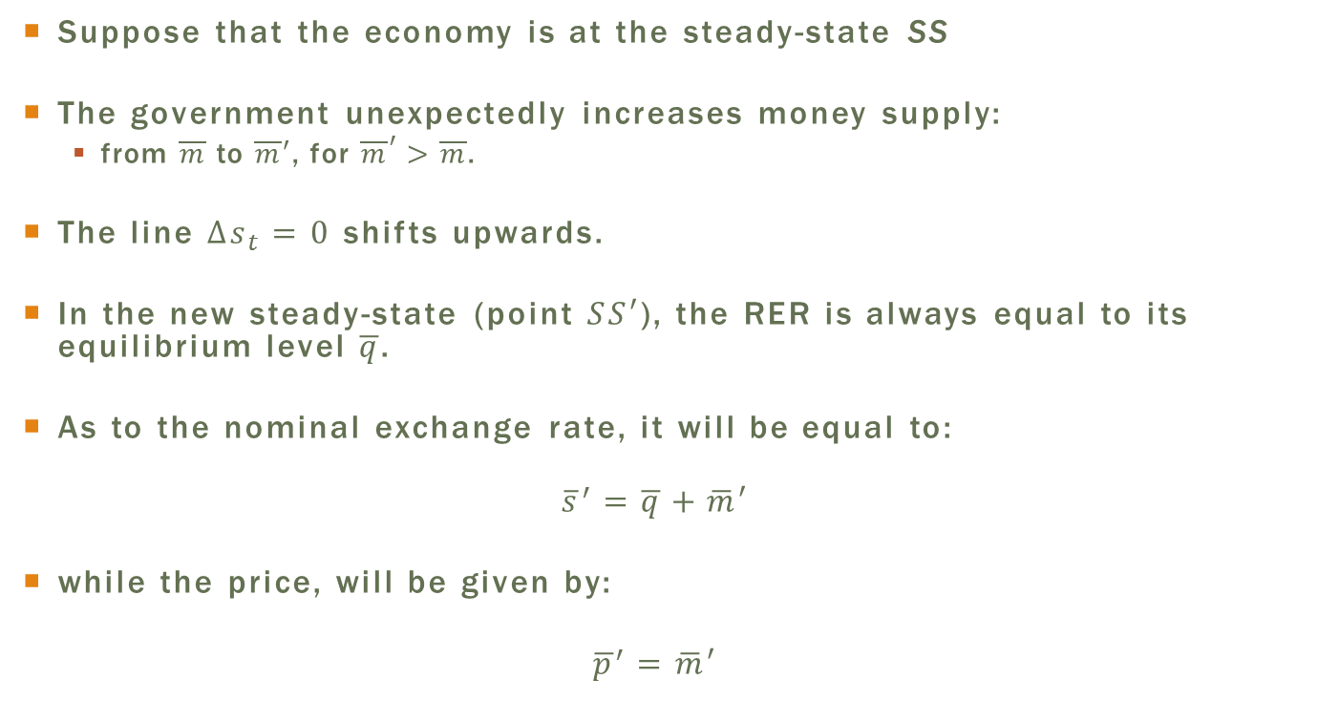
Impact of an Expansionist
Monetary Policy
Suppose that the economy is at the steady-state SS
The government unexpectedly increases money supply:
  from $\overline{m}$ to $\overline{m}′$, for ${\overline{m}}^{′}>\overline{m}$.
The line $Δs_{t}=0$ shifts upwards.
In the new steady-state (point $SS′$), the RER is always equal to its equilibrium level $\overline{q}$.
As to the nominal exchange rate, it will be equal to:
$${\overline{s}}^{′}=\overline{q}+\overline{m}′$$
while the price, will be given by:
$${\overline{p}}^{′}=\overline{m}′$$

Slide 64
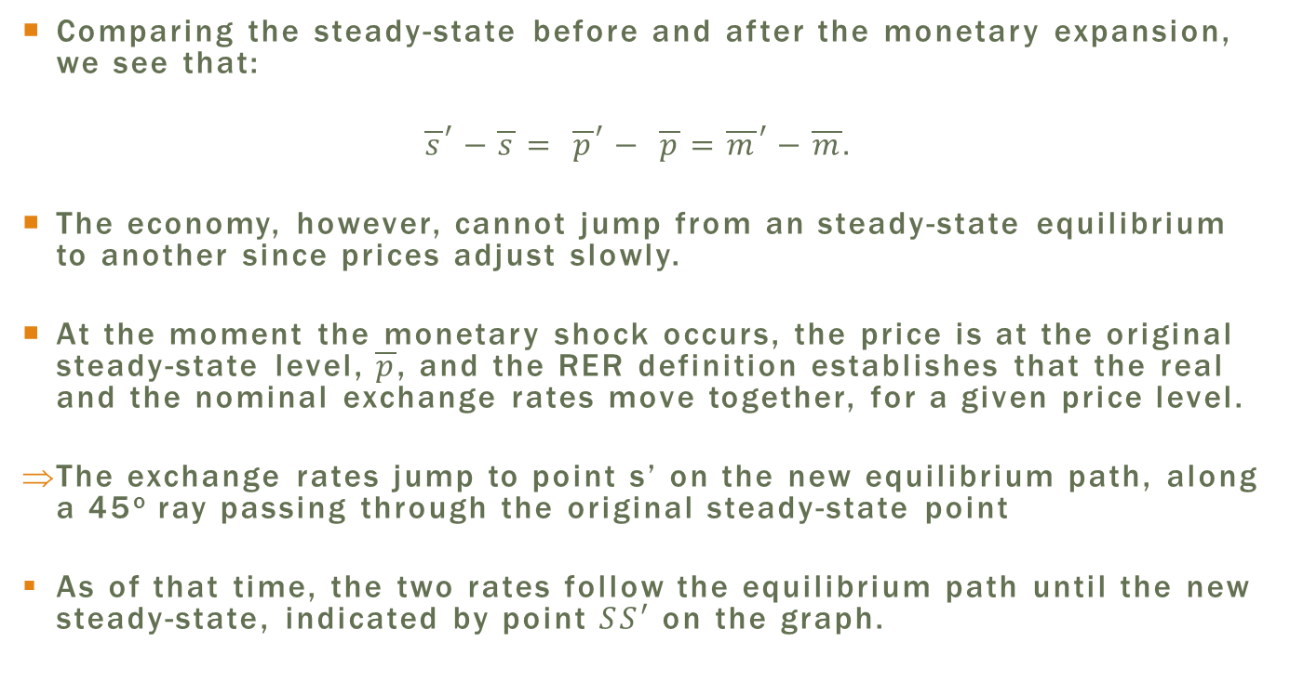
Comparing the steady-state before and after the monetary expansion, we see that:
$${\overline{s}}^{′}−\overline{s}= {\overline{p}}^{′}− \overline{p}={\overline{m}}^{′}−\overline{m}.$$
The economy, however, cannot jump from an steady-state equilibrium to another since prices adjust slowly.
At the moment the monetary shock occurs, the price is at the original steady-state level, $\overline{p}$, and the RER definition establishes that the real and the nominal exchange rates move together, for a given price level.
The exchange rates jump to point s’ on the new equilibrium path, along a 45º ray passing through the original steady-state point
As of that time, the two rates follow the equilibrium path until the new steady-state, indicated by point $SS′$ on the graph.

Slide 65
Expansionist Monetary Policy in the Mundell-Fleming-Dornbusch Model

Slide 66
Exchange Rate Overshooting
Overshooting effect : the exchange rate depreciation in the short run is larger than the depreciation at the new steady-state.
  Restating, the response of the nominal exchange rate to a monetary expansion is magnified in the short run.
After this overshooting, the nominal exchange rate gradually appreciates along the equilibrium path until the new steady-state.
Exchange rate overshooting => the nominal exchange rate is more volatile than the monetary policy and prices.
The same occurs with the RER: it depreciates at the moment of shock, and then gradually appreciates until attaining its long-run equilibrium value.

Slide 67
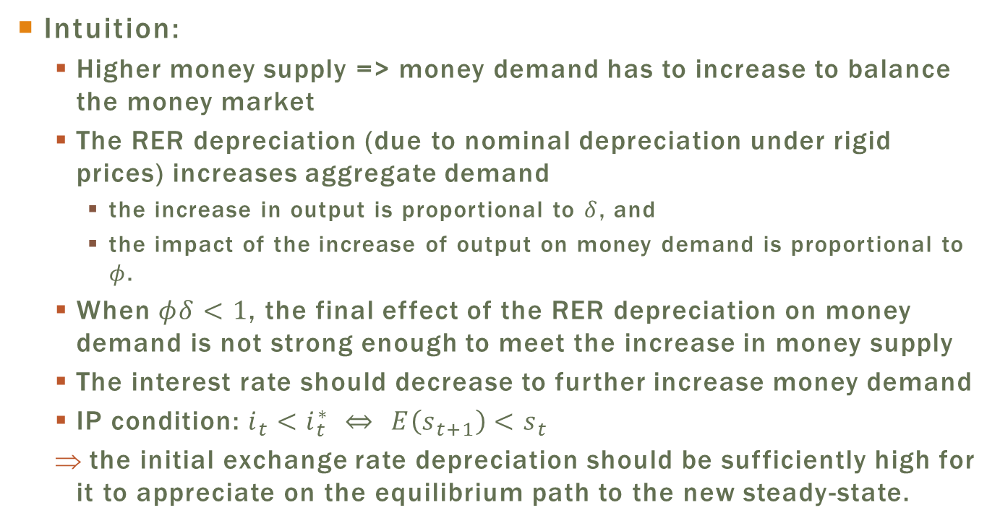
Exchange Rate Overshooting
Intuition:
  Higher money supply => money demand has to increase to balance the money market
  The RER depreciation (due to nominal depreciation under rigid prices) increases aggregate demand
    the increase in output is proportional to $δ$, and
    the impact of the increase of output on money demand is proportional to $φ$.
  When $φδ<1$, the final effect of the RER depreciation on money demand is not strong enough to meet the increase in money supply
  The interest rate should decrease to further increase money demand
  IP condition: $i_{t}<i_{t}^{∗} ⇔$ $E\left(s_{t+1}\right)<s_{t}$
  the initial exchange rate depreciation should be sufficiently high for it to appreciate on the equilibrium path to the new steady-state.

Slide 68
Mundell-Fleming vs. Dornbusch
In the Mundell-Fleming model, where prices are fixed, monetary expansion in a fixed exchange regime leads to the expansion of output and exchange depreciation.
With the dynamics introduced by Dornbusch, we learned that the output, after the initial expansion, returns to its full employment rate at the pace that prices adjust and the economy attains its steady-state.
Therefore, monetary expansion increased output, but only temporarily.

Slide 69
Plan
Rigid Prices: The MundellFleming Model
Sticky Prices: The Mundell-Fleming-Dornbusch Model
Monetary Models with Price Rigidity: Their Uses and Limitations

Slide 70
Monetary Models with Price Rigidity: Their Uses and Limitations
The rigid price monetary models allow the investigation of the real effect of monetary policy.
In these models, the nominal exchange rate adjusts automatically to shocks, while price adjustments are gradual.
It is easy to see that the nominal exchange seems to be indeed more flexible that the prices of goods: we read in the paper that the exchange rate is different from day to day, while prices at the supermarket tend to not change much from one week to the next, when the inflation rate is not high.

Slide 71
Monetary Models with Price Rigidity: No Microfoundations
These monetary models with rigid prices are built with heroic simplifying assumptions not found in current economic models, which tend to be much more sophisticated.
Yet, every economist learns them, not as a curiosity of history of economic thought, but by the fact that they offer a very good intuition to analyze the effects of government policies in the short run under different exchange regimes, that is, before prices react to the changes in policy.
Main criticism: these models are not based on microfoundations, where the relations between the economic variables are derived based on the behavior of individuals, be they consumers, businesses or government, that make decisions in such a way as to maximize their objective function, subject to budget or technological constraints, as be the case, and taking into account the information that is available to them.

Slide 72
Monetary Models with Price Rigidity: Intertemporal considerations
Also, the models in this chapter do not incorporate the intertemporal consequences of public policy.
  The increase in public spending in the Mundell-Fleming model, for instance, raises the public deficit, which should have an impact on future public finances.
  Private agents could, for example, decide to save more to prepare to higher taxes in the future when the budget needs to be rebalanced.
  However, these considerations are not incorporated into the model.
  The increase in public spending translates into an increase in aggregate consumption, with no impact on private consumption.

Slide 73
Monetary Models with Price Rigidity: intertemporal budget constraint
The intertemporal budget constraint for the country is also not taken into consideration.
In the short-run dynamics of the Mundell-Fleming-Dornbusch model, the RER differs from its equilibrium level => the CA balance differs from its optimum level over the transition period.
  A revision would be then be expected of the optimum CA path for the future, which should be reflected in the equilibrium RER level.
If, for example, a country accumulates credit with the rest of the world along the transition, its wealth increases. The increase in wealth should impact the decision to consume and save. The model does not capture this wealth effect.

Slide 74
Monetary model with rigid prices and intertemporal Effects
The results of the Obstfeld and Rogoff (1995) model show the importance of taking into account intertemporal effects.
They show that the income effect causes monetary expansion to have a permanent impact on output, while, in the Mundell-Fleming-Dornbusch model, the output returns to its original level in the long run.
Also, a monetary expansion increases welfare both for the country that puts it into practice and for the rest of the world.
  In principle, it was believed that the rest of the world would be harmed due to the exchange rate depreciation and a consequent deviation of consumption in favor of domestic goods.
  They show that this effect, even though existent, is less important than the positive effect on aggregate world demand when world production is lower than its optimal level due to the monopoly power of producers.

Slide 75
Monetary model with rigid prices and intertemporal Effects
Problem with the model from Obstfeld and Rogoff (1995): much more complex than the models presented here.
  not possible to solve the model analytically, nor to perform a graphic analysis as we have done here.
The extensive literature that was developed based on the model shows that the results are, actually, quite sensitive as to the hypotheses used in relation to
  the nature of price rigidity,
    the specification of preferences and
    the financial structure
In sum, for practical purposes, the Mundell-Fleming and Mundell-Fleming-Dornbusch models remain as relatively simple and efficient alternatives for us to study the main effects of monetary and fiscal policies on exchange rate and income.

